Slide 2
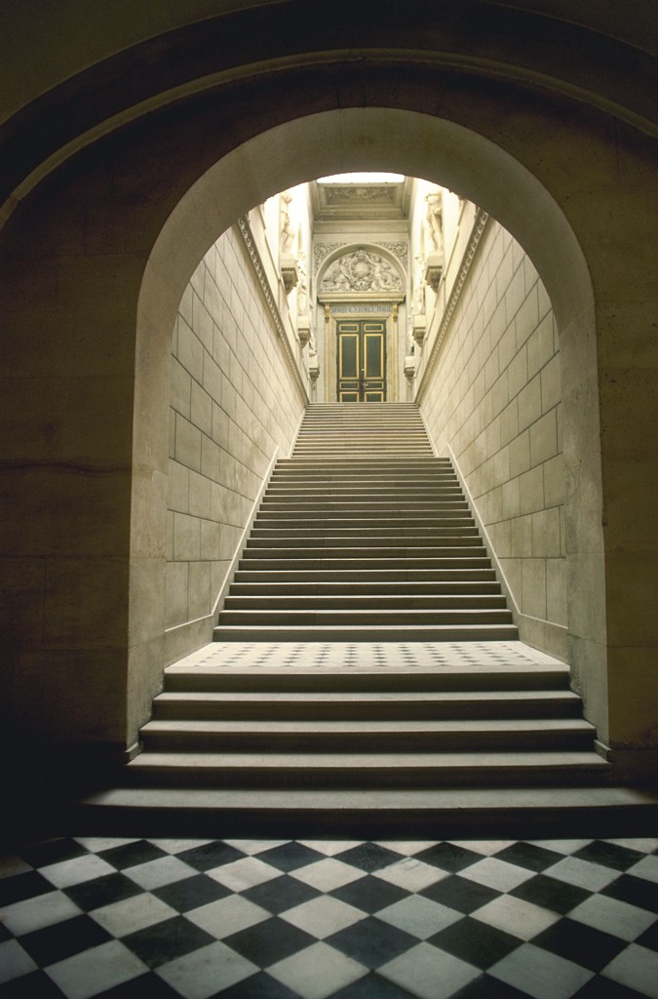
Heaven’s King
at the door
“Behold, I stand at the door and knock. If anyone hears My voice and opens the door, I will come in to him and dine with him, and he with Me” (Rev. 3:20)
Notes:
Revelation 3:20 will be the basis for our lesson today. It is an interesting statement and a very interesting picture of the Christ standing otside the door of the church at Laodicea and beckoning anyone to hear his voice.

Slide 3
“I Stand at the Door and Knock”
“ ² Bride I sleep, but my mind is awake. Listen! My beloved is knocking. Groom Open to me, my true love, my sister, my dove, my perfect one. My head is wet with dew, my hair with the dewdrops of night. ³ Bride I have taken off my clothes! Why should I put them on again? I have washed my feet! Why should I get them dirty again? ⁴ My beloved put his hand through the keyhole. My heart throbbed for him. ⁵ I got up to open for my beloved. My hands dripped with myrrh, and my fingers were drenched with liquid myrrh, on the handles of the lock. ⁶ I opened for my beloved, but my beloved had turned away. He was gone! I almost died when he left. I looked for him, but I did not find him. I called for him, but he did not answer me.”
–Song of Solomon 5:2-6 (GWV)
THE DOOR
  can only be opened from the inside
  represents the heart
  no power can open it apart from man’s consent
Notes:
[CLICK X4] Jesus maybe referring to that familiar Song of Solomon scene where the husband comes to the door and the bride doesn’t open it up in time because of her slumber and minor distractions (viz. garment off; feet washed).
Once she was fully aroused she comes to the door and doesn't find her husband. The beloved had tried to unlock the door, his myrrh remained as evidence. Ironically, she then went to travel the streets in Jerusalem to look for her beloved to only received violence from the watchmen. Her beloved was once so close, but now so far away.
When Jesus stands at the door, we must open immediately and not delay. He will not remain there forever. Inconveniences of getting out of bed, slipping on a robe should be nothing to be with the Lord. Yet people complain about getting baptized as some meritorious work of man in order to get clothed with Christ (Gal. 3:27)! You will also find those married to Christ complain about coming to services to worship Him!
This woman in the Song of Solomon who is slow to answer the door for her lover seems to answer with the “lukewarmness” of the Laodiceans to Christ.
Let me say this. . .we do see the patience and love of Jesus, because even though He had nothing good to say about the church at Laodicea, unlike the shepherd to his wife in the Song, and even though He likened them to vomit, he was still willing to knock on their door and seek to come in.

Slide 4
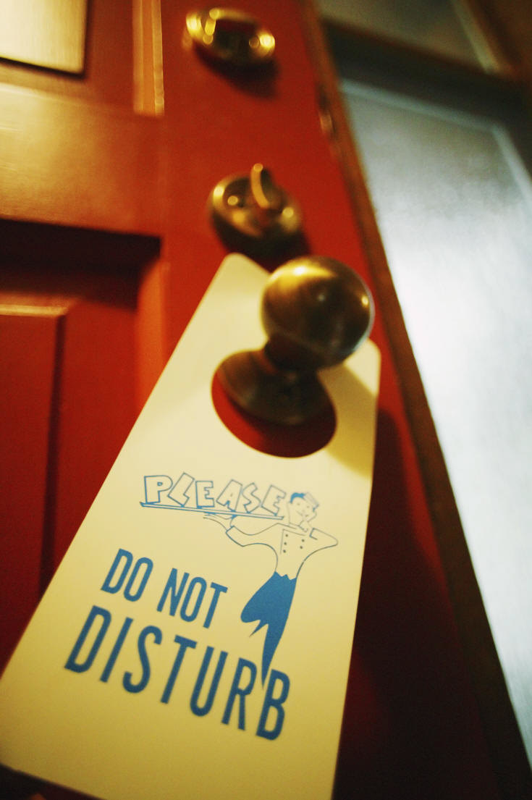
“I Stand at the Door and Knock”
THE CHURCH
  Revelation 3:14-22
why would a church not open her door to the Christ?
  lukewarm (v. 16)
  inflated view of themselves (v. 17)
  naked (v. 18)
  too blind to find the door (v. 18)
  are not interested in repenting (v. 19)
Notes:
Read Rev. 3:14-22
[CLICK X6]

Slide 5

“I Stand at the Door and Knock”
THE CHURCH
  Revelation 3:14-20
When does a church close the door (2 Tim. 4:2-5)?
  When she no longer endures sound doctrine
  When she has her own desires
  When she has itchy ears
  When she turns her ears away from the truth

Slide 6
“I Stand at the Door and Knock”
THE CHURCH
  Revelation 3:14-20
Christ was once in that church!
  from in their heart to standing outside the door knocking (cf. Eph. 3:17)
  had fellowship with brethren in Colossae (Col. 4:15, 16)
time can test and erode our faith
pride can drive Him out
Notes:
[CLICK X2] While Jesus is outside of their heart in Revelation, he wasn’t always. In order to become a Christian and a part of the church, Christ must have at one time resided there (Eph. 3:17).
[CLICK] Colossians 4:15, and 16 shows a high degree of fellowship was to exist between Colossae and Laodicea. They were to “greet them.” They were to share the letters Paul had written.
Not only does this passage show that Laodicea was once worthy of fellowship, but it also shows that the canon of scripture was already being compiled.
Note: "the epistle from Laodicea." Is this a lost epistle? Well, the apostles had power to write to all churches. I doubt all that they ever wrote was placed in the scriptures (1 Cor. 5:9, 11 “but now”; also of the many things that Jesus did were not placed in written form Jn. 21:25).
Paul simply states of a letter “from” Laodicea. If Laodicea had been given the letter to the Ephesians to read and that letter was then to be sent to Ephesus, then “Ephesians” would be “from” Laodicea and would not be a lost letter.
[CLICK X2]

Slide 7
“I Stand at the Door and Knock”
THE CHURCH
  Revelation 3:14-20
“have need of nothing” (v. 17)
  “For My people have committed two evils: They have forsaken Me, the fountain of living waters, And hewn themselves cisterns––broken cisterns that can hold no water” (Jer. 2:13)
  “For if anyone thinks himself to be something, when he is nothing, he deceives himself” (Gal. 6:3)
Notes:
[CLICK] You might appreciate that becoming wealthy can often bring with it a downfall of self-dependence and ultimate alienation from God. It doesn’t have to. I have seen wealthy Christians maintain their humility and reverence with God and I have seen others who are all wrapped up in themselves. Laodicea was of the latter group.
[CLICK X2] We often only leave God when we feel comfortable of replacing God. We must see ourselves as small.

Slide 8
PERCEIVE our smallness
“So Samuel said, ‘When you were little in your own eyes, were you not HEAD of the tribes of Israel? And did not the LORD anoint you KING over Israel?’”
(1 Sam. 15:17)
Notes:
It was when big Saul saw himself as small that God exalted him (cf. 1 Sam. 9:21; Solomon 1 Kin. 3:7-9).

Slide 9
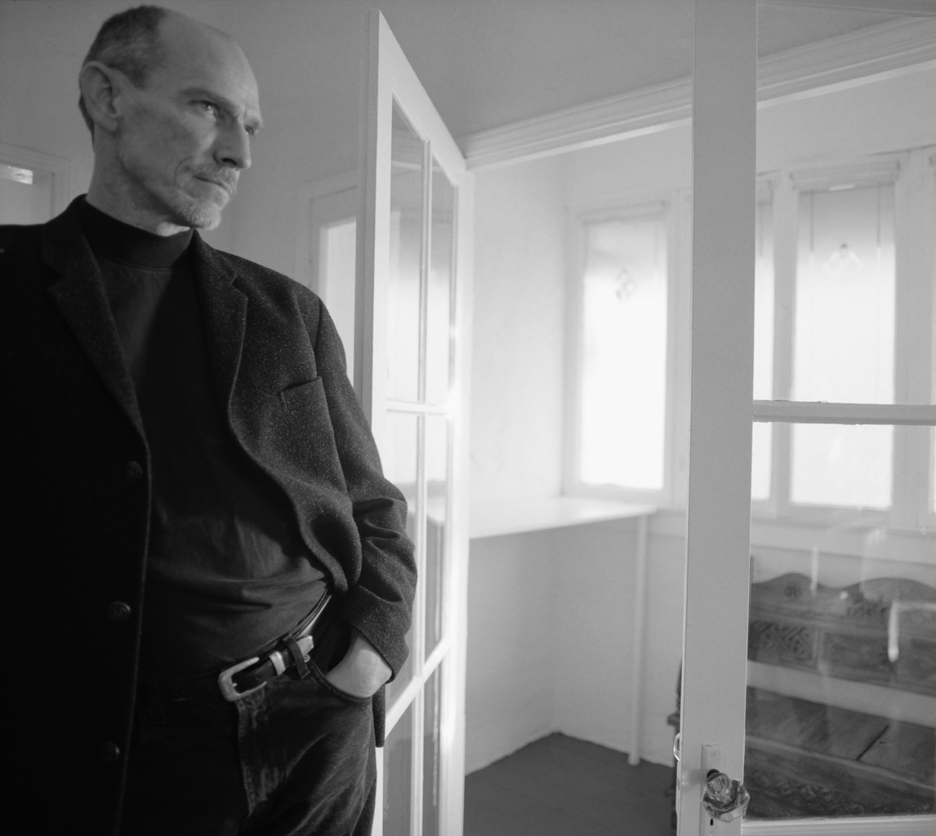
“I Stand at the Door and Knock”
THE CHURCH
  Revelation 3:14-20
why would Jesus knock at the door?
  he wants to dine
    would great men honor you this way?
Notes:
[CLICK] This seems like a fair question to ask. Why?
[CLICK thru]

Slide 10
“I Stand at the Door and Knock”
THE CHURCH
  Revelation 3:14-20
why would Jesus knock at the door?
  he wants to preserve you (3:18)
    it is for your own good
    he is not in need of us; we are in need of Him
    attempt at reconcilia-tion began with Savior (Lk. 19:10; 1 Jn. 4:19; Rom. 5:8)
  he loves you (v. 19)
Notes:
[CLICK X2]
We see in this picture that Jesus takes the initiative to reconcile. He goes to the door. He stands at the door. He knocks on the door. He calls out or speaks at the door. We see that this is consistent with other passages too.
"for the Son of Man has come to seek and to save that which was lost" (Lk. 19:10)
"We love Him because He first loved us" (1 Jn. 4:19)
"But God demonstrates His own love toward us, in that while we were still sinners, Christ died for us" (Rom. 5:8)
[CLICK] In short, He is at the door knocking because he loves you.

Slide 11
“I Stand at the Door and Knock”
THE CHURCH
  Revelation 3:14-20
how does Jesus entreat?
  knocking & talking
    desire admittance
    recognizes the rights of others—FREE WILL!
  not kicking, not pounding, not keying
  he doesn’t obtrude upon anyone
  he calls through the gospel (2 Thess. 2:14)
“to which He called you by our gospel, for the obtaining of the glory of our Lord Jesus Christ”
Notes:
How Jesus entreats is a dimension worth considering. [CLICK thru]
He desires admittance.

Slide 12
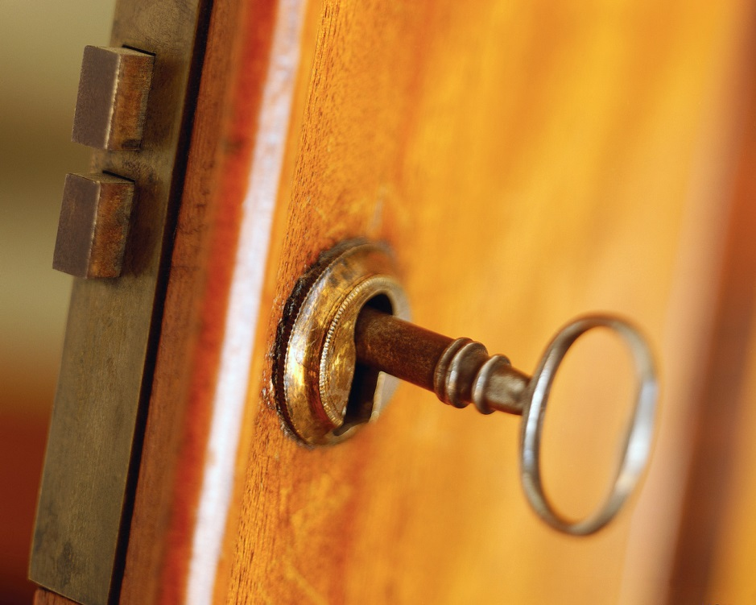
No “Faith Only” in Revelation 3:20
“. . .If anyone hears My voice”
AND
opens the door. . .”
He doesn’t open the door
He doesn’t own the key to the door
He doesn’t make you hear his word
Notes:
It seems that Jesus is pleading for “anyone.” Just one. Won’t even one hear and open? This supports the idea that there was no one fit for heaven in the church at Laodicea. At Sardis there were at least some with robes undefiled. But what about Laodicea?
[CLICK X3]
Jesus has the keys to Hades and death (Rev. 1:18). While he can open Hades he cannot open your heart apart from your will.
He doesn’t cram His church into into anyone's hearts. He doesn't force feed faith. You must be willing to hear and you must be willing to believe. Without such, Jesus can do absolutely nothing for you of any eternal benefit.

Slide 13

The Danger of Leaving the Door Closed
Sodom didn’t open the door to God (Gen. 19)
  destroyed
Felix & Drusilla didn’t open the door to God (Acts 24:24-25)
  destroyed
Agrippa didn’t open the door to God (Acts 26:28)
  destroyed
Notes:
Sodom - After Lot called homosexuality "wicked" to the men of Sodom (Gen. 19:7); they responded,
"And they said, "Stand back!" Then they said, "This one came in to stay here, and he keeps acting as a judge; now we will deal worse with you than with them." So they pressed hard against the man Lot, and came near to break down the door."
Lot obviously had a tract record of condemning their lawless deeds and they wanted to repay him with evil. Peter tells us that his soul was tormented by hearing and seeing their lawless deeds (2 Pet. 2:7, 8). Who is to say that God was not beckoning them to repentance through Lot's judgments? Ultimately they were destroyed for not repenting.
Felix and Drusilla - The time never came for them to obey the gospel and let the Lord dine in their heart. Felix would soon be dismissed from his office in disgrace and Drusilla perished in the eruption of Mount Vesuvius.

Slide 14
Will You?
Open the door of your heart in faith?
Open your heart to repent of any manner of life that is opposed to godliness?
Open your mouth to confess Christ (Rom. 10:8-10)
Open your will to be buried with Christ in baptism for the remission of all your past sins (Col. 2:12, 13; Acts 2:38)?

